Slide 1
Module 5: Sampling
5.5: Simple probability samples
Annie Collins
Data Sciences Institute, University of Toronto

Slide 2
Learning Outcomes
How might we select and study random individuals from a population? How do we effectively analyze a sample selected in this manner?
Distinguish between different types of probability samples
Compute sample statistics for simple random samples
Identify scenarios in which certain probability sampling methods should be used or avoided

Slide 3
Simple Probability Samples

Slide 4
Probability Sampling
Probability sampling is a sampling method in which every population unit has a selection probability that is known to those conducting the sampling, and units are selected at random.
Small probability samples can be used to make inferences about relatively large populations

Slide 5
Types of Probability Samples
A simple random sample (SRS) is taken when every possible combination of population units has an equal chance of being sampled
A stratified random sample is taken when a population is divided into sub-groups called strata and independent simple random samples are selected from each stratum. Strata are usually selected based on shared characteristics, like age or geographic location.
A cluster sample is taken when a population is divided into sub-groups (clusters) that act as the primary sampling units. Clusters are sampled using an SRS, and each individual in the cluster is surveyed or observed.
A systematic sample is selected using a list of sampling units. A random starting point in the list is selected and then every k^{th} subsequent unit is selected to be in the sample.
Notes:
NOTE: this module only covers SRS and systematic sampling. Cluster and stratified random sampling are covered in their own modules

Slide 6
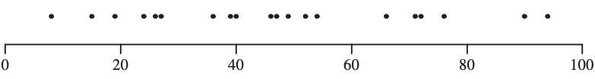
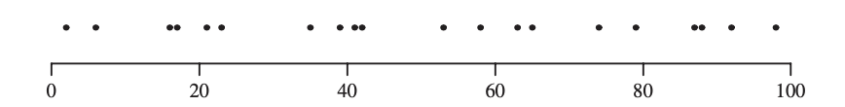
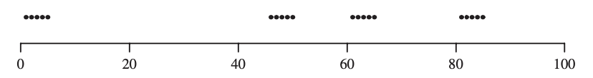
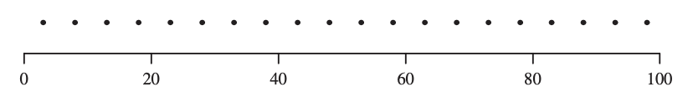
Sampling 20 integers from {1, 2,...,100} (Lohr, 2019, Figure 2.1)
Simple random sample
Stratified random sample
Cluster sample
Systematic sample

Slide 7
Sampling With versus Without Replacement
Consider a population of size N
Simple random sampling with replacement:
Select one unit for measurement, with probability 1/N
Sampled unit is return to the population
Select second unit for measurement, with probability 1/N
Repeat until desired sample size is obtained
Simple random sampling without replacement:
Select one unit for measurement, with probability 1/N
Select second unit for measurement, with probability 1/(N-1)
Repeat until desired sample size is obtained. The final unit in the sample will be selected with probability 1/(N-n+1), where n is the total sample size.

Slide 8
Sample Estimates and Variability for SRS

Slide 9
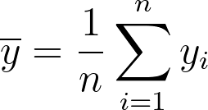
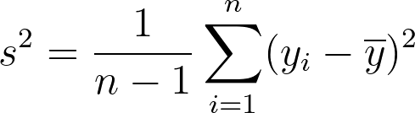
Sample Mean and Variance
Consider a sample of size n from a population of size N.
The population mean, 𝝁, can be estimated using the sample mean, , calculated,
for x_{i} representing each unit in the sample. is an unbiased estimator of 𝝁.
The sample variance, s², can be calculated,

Slide 10
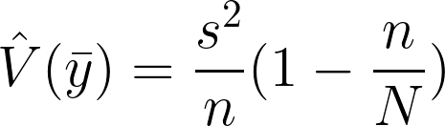
Estimator Variance
The variance of is,
This is a measure of the variability of values of computed from different samples.
n/N is called the sampling fraction and represents the proportion of individuals from the population captured in the sample.
(1 - n/N) is called the finite population correction.
As sample size increases, the value of the sampling fraction increases and the value of the finite population correction (and thus, estimate variance) decreases
As sample size increases, we gain more information about the population, and the variance of our estimate decreases

Slide 11
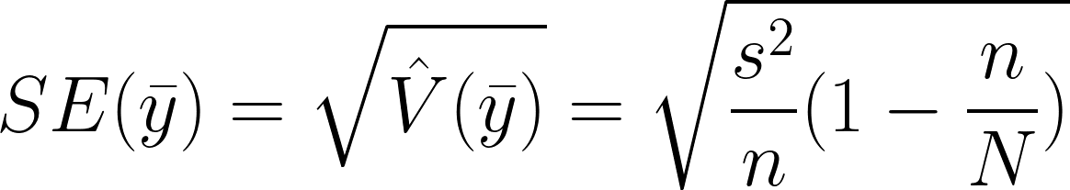

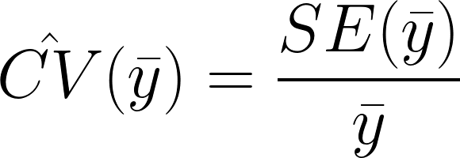
Standard Error and CV
The standard error (SE) is the square root of the estimated variance of :
The SE can be used to calculate the coefficient of variation (CV) for :
The CV is a unitless measure of relative variability. The estimated CV is the SE expressed as a percentage of the sample mean.

Slide 12
Weights

Slide 13
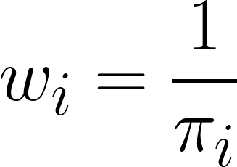
Sampling Weights
Let 𝜋_{i} be the probability that population unit i is included in the sample.
Then the sampling weight of unit i is defined as,
The sampling weight can be interpreted as the number of population units that a given unit in the sample represents.

Slide 14


SRS Sampling Weights
All units have the same inclusion probability (by definition) –
All sampling weights are the same –
Each unit in the sample represents the same number of population units
This is called a self-weighting sample

Slide 15
Systematic Sampling

Slide 16
Systematic Sampling
Obtain a randomized list of the population (size N).
Choose a sample size n.
Calculate N/n. If N/n is an integer, let k = N/n. If it is not an integer, let k be the next integer after N/n. k is the selection interval.
Select a random integer R between 1 and k. R is the starting point for the sampling procedure.
Working through the list, sample units R, R+k, R+2k, etc. until the end of the list is reached.

Slide 17
Systematic Sampling Considerations
Systematic sampling is a type of cluster sampling, not SRS
If the original population is truly randomized, systematic samples behave similarly to SRS and the same analysis methods can be used
If the original population is in increasing or decreasing order, or periodic in some way (i.e. alternating male and female names), the sample will not be representative and will not behave like an SRS
Usual considerations apply when defining a target population and frame
From what source are you obtaining your list? If sampling in person, where are you sampling?

Slide 18
When should an SRS be used?

Slide 19
When should an SRS be used?
When you have a complete list of and access to all possible observation units
If your original list is not comprehensive, an SRS will not be representative and the usual analysis methods will not be possible
If the geographic area covered by the original list is too large, an SRS may contain units that cannot be observed and the usual analysis methods will not be possible
When there is little supplementary information about the population that can be used to design the survey/study
This eliminates the possibility of stratified or cluster sampling
When the main focus of the survey/study is multivariate relationships
Analysis can be much simpler for an SRS

Slide 20
Next
5.6 Stratified sampling

